Slide 1


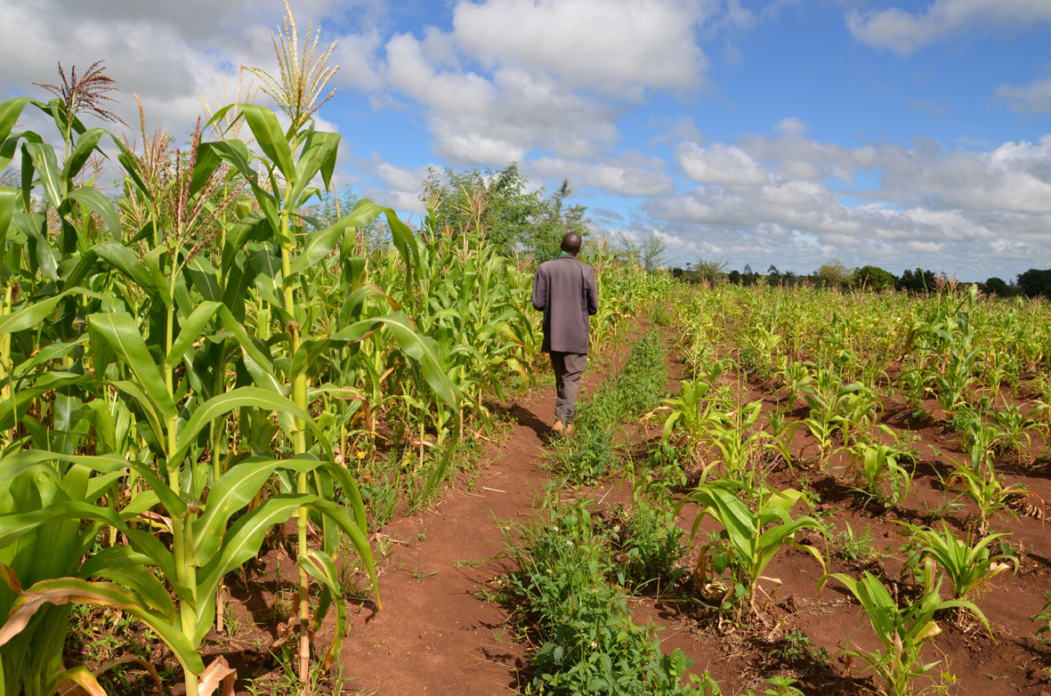

TAMSAT-ALERT for Impact-Based Forecasting
Session 6: Course review

Slide 2
Learning objectives
Explain TAMSAT-ALERT soil moisture and WRSI as a drought impact-relevant metric
Understand modelling of soil moisture and WRSI
Understanding TAMSAT-ALERT approach to forecasting
Ability to interpret TAMSAT-ALERT soil moisture and WRSI forecasts
Ability to produce TAMSAT-ALERT forecast plots and/or bulletins

Slide 3
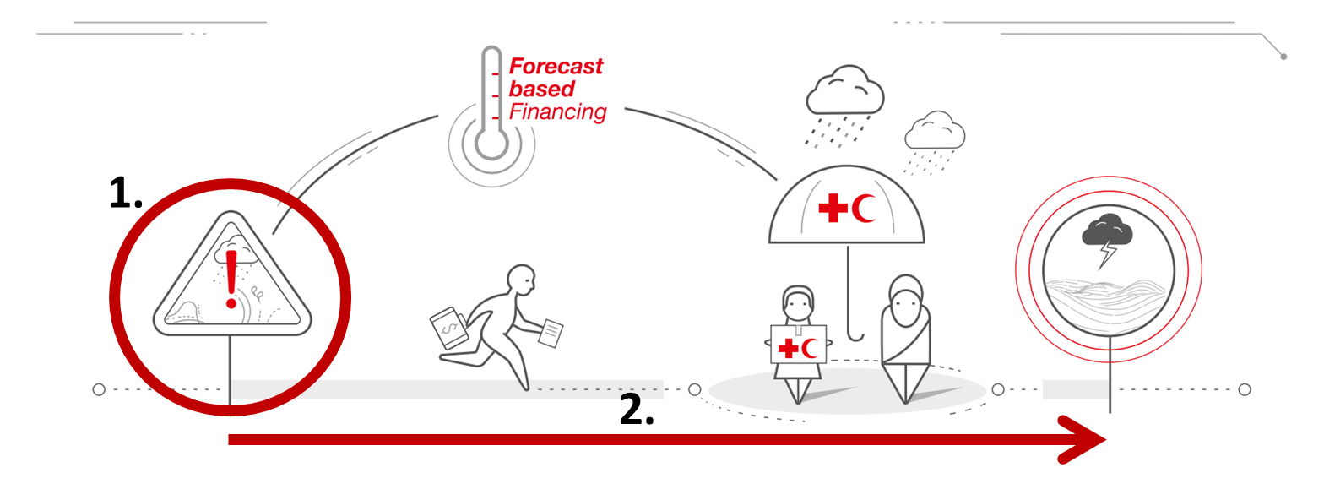
Session 2: Validation of TAMSAT-ALERT
Explain TAMSAT-ALERT soil moisture and WRSI as a drought impact-relevant metric
TAMSAT-ALERT soil moisture metrics relate to the impacts of drought
TAMSAT-ALERT forecasts provide sufficient lead-time for early action
There are caveats associated with the use of TAMSAT-ALERT soil moisture forecasts

Slide 4
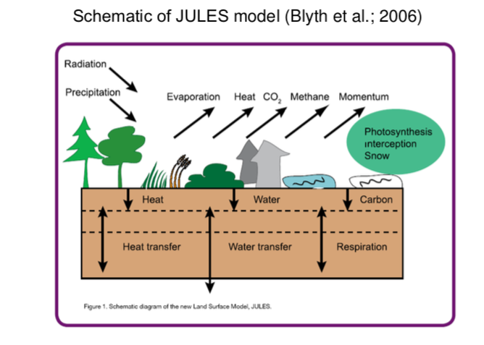
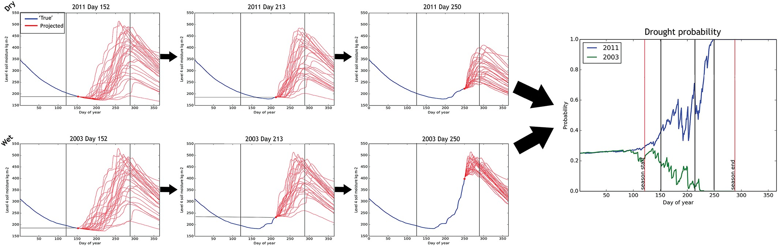
Session 3: TAMSAT-ALERT methodology
Understand modelling of soil moisture and WRSI
Understanding TAMSAT-ALERT approach to forecasting

Slide 5
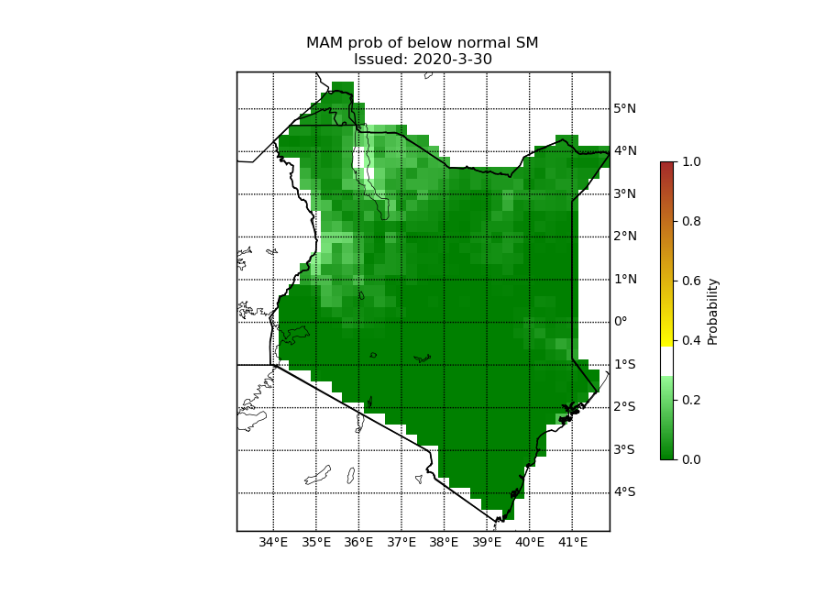
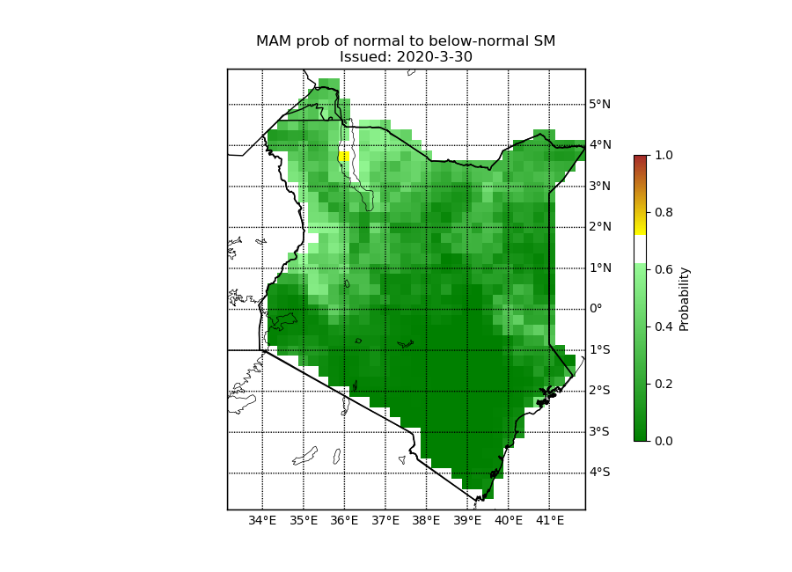
Session 4: Interpreting TAMSAT-ALERT forecasts
Ability to interpret TAMSAT-ALERT soil moisture and WRSI forecasts

Slide 6
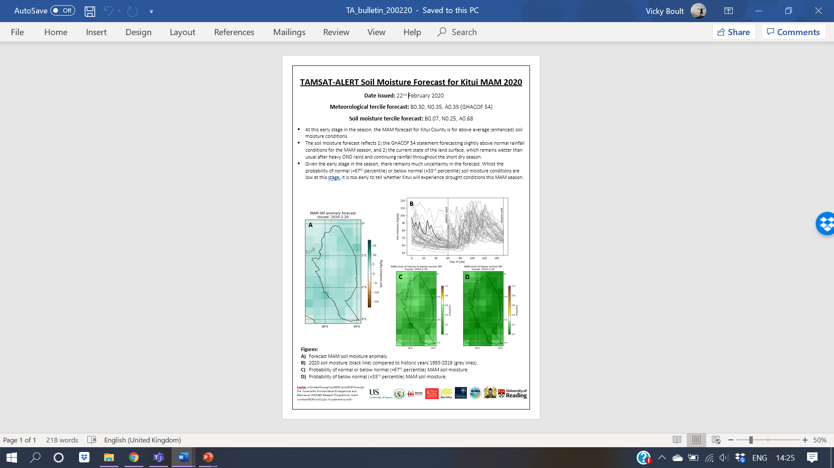
Session 5: Producing TAMSAT-ALERT forecasts
Ability to produce TAMSAT-ALERT forecast plots and/or bulletins

Slide 7
Summary
From TAMSAT-ALERT methodology to producing your own TAMSAT-ALERT forecasts
Consider possible applications in your own work
Thanks for taking part! We hope you enjoyed it!
Please fill in the feedback form that will be distributed to you

